Slide 1

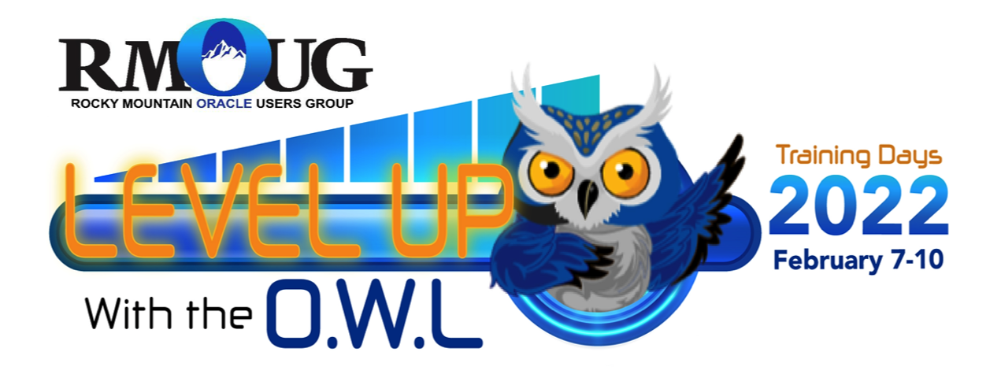
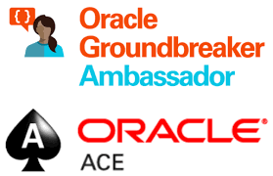
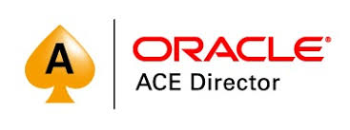
6R-einventing Oracle Systems in a Cloudy World
Lucas Jellema Architect & CTO AMIS | Conclusion

Slide 2



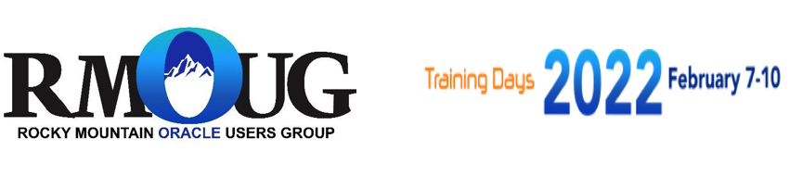
Lucas Jellema CTO for AMIS | Conclusion Cloud Solution Architect 27 years of professional Oracle experience
lucas.jellema@amis.nl | technology.amis.nl | @lucasjellema | lucas-jellema

Slide 3
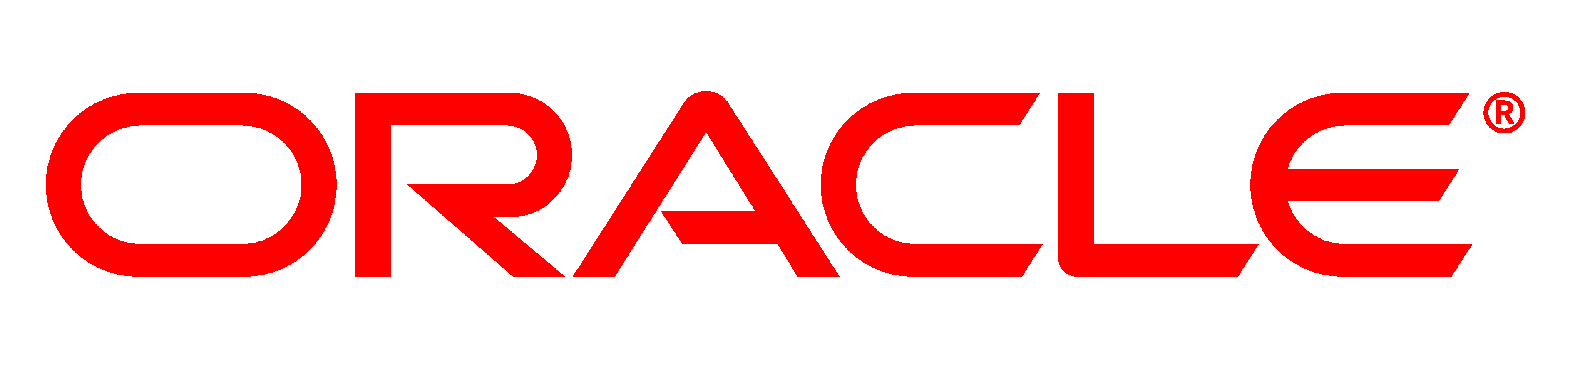

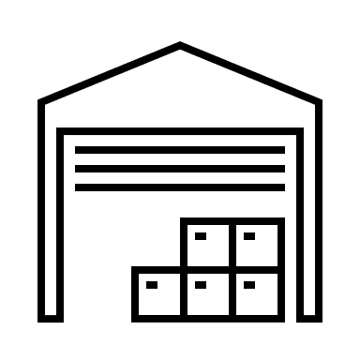
Once upon a time
high technical debt
business critical
end of scale
high incident rate
no tests, no specs, no docs
no evolution
unsupported
little expertise left on applications and tech stack
old
security-challenged
inflexible
A Dutch Company
not modern
expensive: high TCO
fragile
legacy
Their on premises data center (in Germany)
custom software
monolith
unattractive technology stack for young talent
business ⬄ IT gap

Slide 4



Cloud Promises
Latest and Greatest
Rapid Innovation
Pay for use only (no CAPEX)
Low TCO
Super Secure
Fully managed
Limitless scalability
Automation
Fine grained cost control
The Moon

Slide 5

Once upon a time is … about now
They have 25+ years Oracle technology stack and staff expertise
100s custom applications (Forms, Reports, APEX, Pro*C, PL/SQL, ODI, SOA Suite)
dozens of production databases = business critical
outsourced most of Ops and much of Dev
flirts with iPaaS, low code, microservices, mobile devices
Unhappy with IT
slow, restricting, expensive, old, fragile, not innovative, customer facing (customer frustrating)
they associate Oracle with their current IT state of affairs
They have embarked on a cloud transformation:
Azure is their preferred IaaS and PaaS cloud
they expect a hybrid and multi-cloud landscape with several SaaS offerings, on premises systems and 3rd party PaaS

Slide 6


Cloud

Slide 7
IaaS
IaaS Latest infrastructure
Automation: Programmable / Infrastructure as code Dynamically Scalable
Secure
Distributed (fail over locally and regionally)
Pay for use
Rapid take-off

Slide 8
PaaS
PaaS Fully Managed services
Instant ramp-up
Highly Available
Always Latest and greatest platform functionality
Dynamically scalable
Serverless
Enterprise grade services for start ups (pay per use)
Monitoring, logging, automation, security, audit, events, … out of the box
IaaS

Slide 9
SaaS
PaaS
SaaS (COTC)
Fully Managed
Fully Functional
Good Practices
Configuration & Data Load, Implementation
Integration (SaaS Enablement)
IaaS

Slide 10





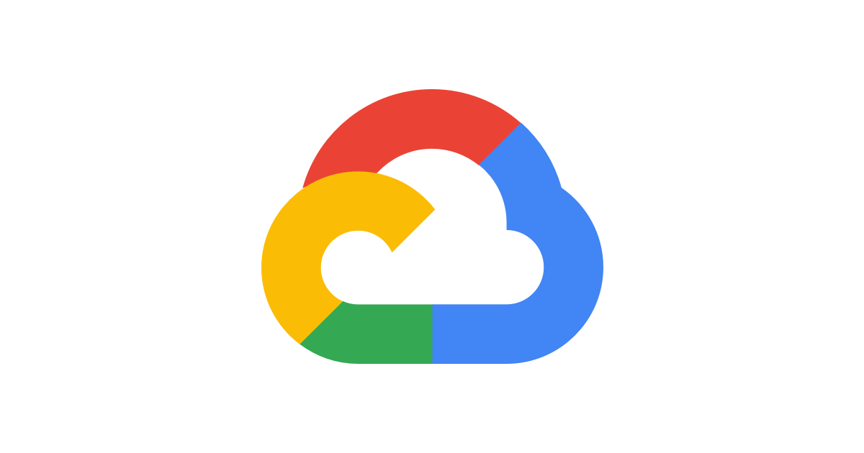
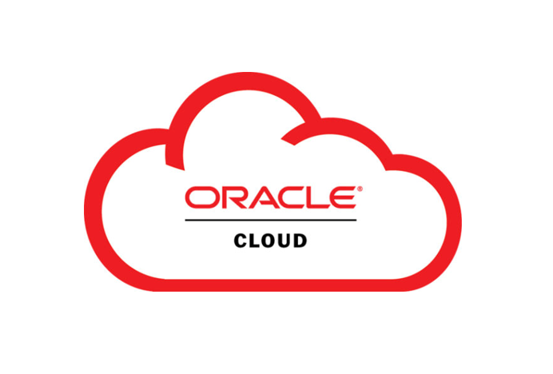
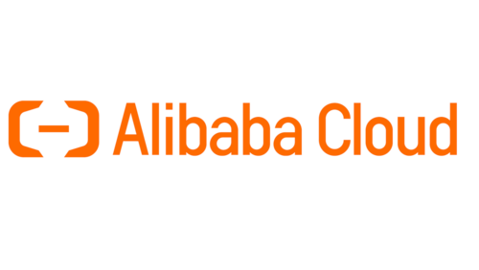
SaaS
PaaS
IaaS
Cloud
Multi Cloud
Public Cloud on Premises
Vendor Lock-in
Network Latency
Data Egress cost
Physical location of cloud data center (& laws)
Strategic relation cloud vendor

Slide 11

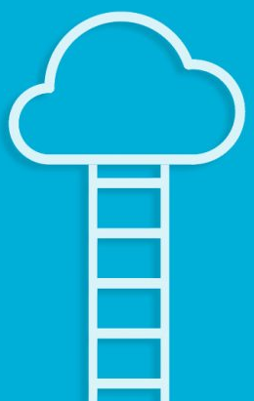
Cloud gives pause
Rethink
Reset
Reject
Reflect
Reconsider
Respect
Rearchitect
Remember
Remind
Renovate
Refresh
Revitalize

Slide 12
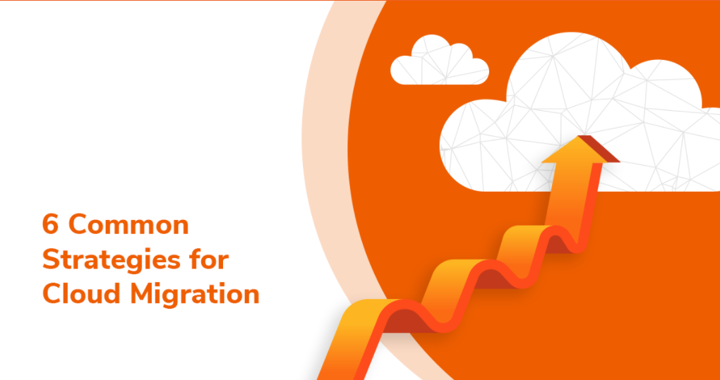

6R
SaaS
PaaS
IaaS
Notes:
retire
retain
rehost
replatform
refactor (rearchitect, renovate, cloud natify)
repurchase/replace

Slide 13
6R - Retire
SaaS
PaaS
IaaS
Decommission – either instead of or following a migration to the cloud
Notes:
retire
retain
rehost
replatform
refactor (rearchitect, renovate, cloud natify)
repurchase/replace

Slide 14
6R – Retain (and Refurbish)
SaaS
PaaS
Not (yet) to cloud. Latency or special hardware could be a consideration; also: application life cycle state. Make sure to do | consider technical upgrade on prem (of hardware, OS, platform, libraries, tools)
IaaS
Notes:
retire
retain
rehost
replatform
refactor (rearchitect, renovate, cloud natify)
repurchase/replace

Slide 15
6R – Rehost (and Refurbish) aka Lift & Shift or: Move and Improve
SaaS
PaaS
IaaS
Run systems as-is on cloud based, automated infrastructure; no changes in platform (except upgrade) and application
Notes:
retire
retain
rehost
replatform
refactor (rearchitect, renovate, cloud natify)
repurchase/replace

Slide 16
6R – Replatform (aka “Lift, Tinker and Shift”)
SaaS
PaaS
Leverage (more) cloud capabilities without substantially changing the code and architecture of applications – but with some optimizations and changes in configuration. For example: fully managed services (“autonomous”)
IaaS
Notes:
retire
retain
rehost
replatform
refactor (rearchitect, renovate, cloud natify)
repurchase/replace

Slide 17
6R – Refactor & Rearchitect
Fundamental changes to architecture, code base, data model and technology stack in order to benefit from cloud to the fullest (managed services and cloud native)
SaaS
PaaS
IaaS
Notes:
retire
retain
rehost
replatform
refactor (rearchitect, renovate, cloud natify)
repurchase/replace

Slide 18
6R – Repurchase (aka Drop & Shop)
Replace an application (bespoke or COTS) with a SaaS offering (COTC) – typically including data migration, (re)implementation, integration and custom complements to provide features lacking in SaaS
SaaS
PaaS
IaaS
Notes:
retire
retain
rehost
replatform
refactor (rearchitect, renovate, cloud natify)
repurchase/replace

Slide 19
6R
Repurchase
SaaS
Refactor
PaaS
Replatform
IaaS
Rehost
Retain & Refurbish
Retire
SaaS
PaaS
IaaS
Notes:
retire
retain
rehost
replatform
refactor (rearchitect, renovate, cloud natify)
repurchase/replace

Slide 20
Considerations when deciding on 6R and migration plan
Business Roadmap
Staff (knowledge, experience, ambitions, state of mind)
Licenses & Support
Load on systems (patterns & peaks – and flatlines)
Technical state (of hardware, infrastructure, technical components)
Accounting and finance - TCO, depreciation, IT budgeting, cost allocation
Innovation (two-pace IT)
Network Latency (embedded software, real time equipment control, IoT Edge)
Security and Regulations & Legislation – what is mandatory and restricted
Strategic: AWS = Amazon == Retail; AliBaba = China, <many> == US
Architecture Roadmap and Principles
Offer (of the day)
Migration
cost, effort, time, requirements, impact
dependencies (access, latency), clustering

Slide 21
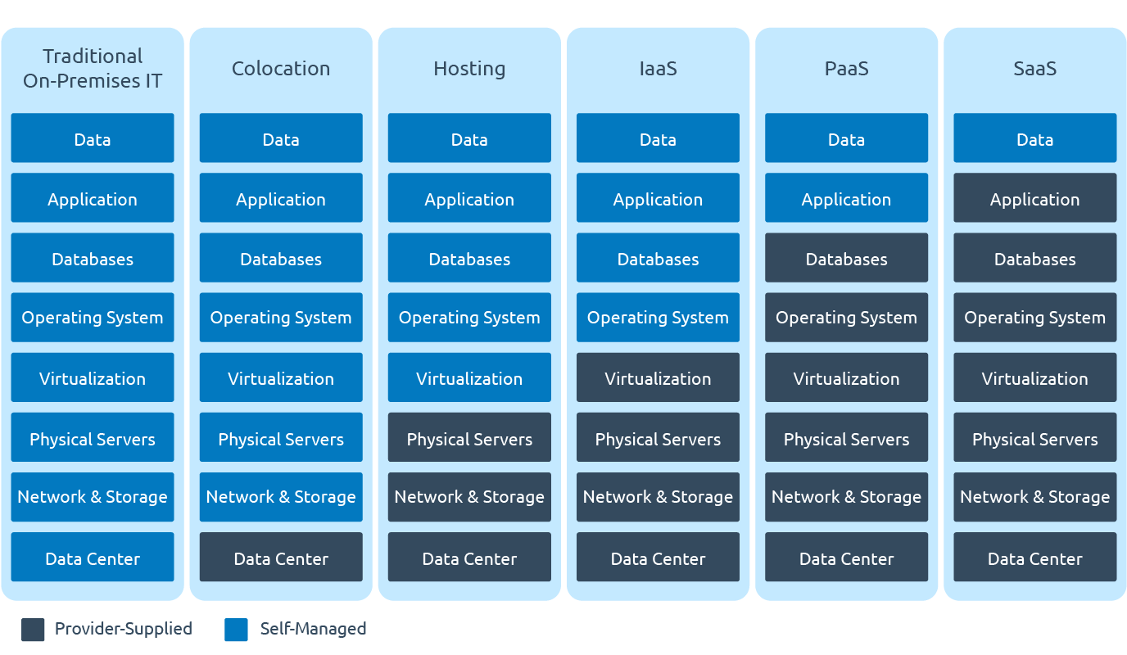
Refactor
Retain & Refurbish
Rehost
Repurchase
Replatform
Retire
IT focus on functional, business specific value
control over technical details

Slide 22
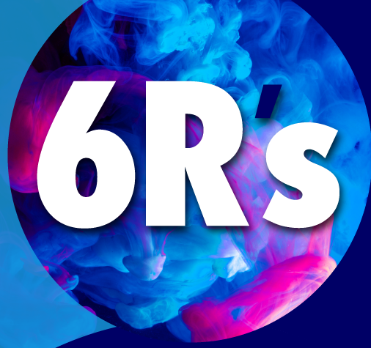
High level comparison of R-implementation
 | Effort | Risk | Agility (non-functional & functional) | TCO reduction
Retire | low | low | zero | very high
Retain (& Refurbish) | low | medium | low | low
Rehost | medium | medium | medium | medium
Replatform | high | high | medium | high
Refactor | very high | very high | very high | very high
Repurchase | high | very high | high | high

Slide 23
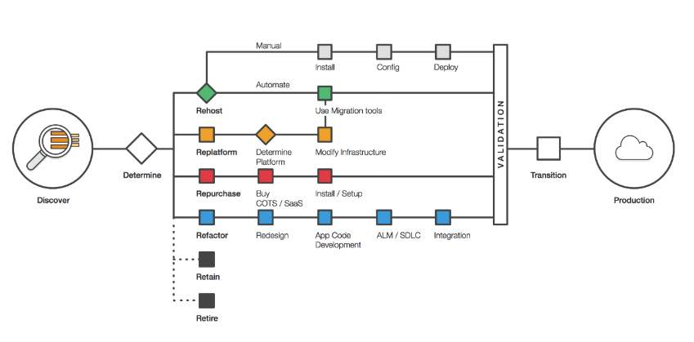

Slide 24
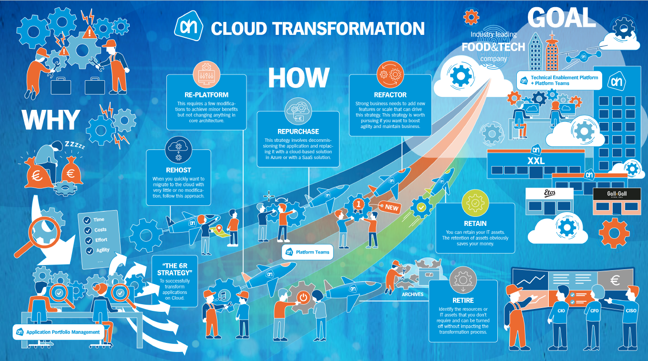
Pharmaceutical

Slide 25
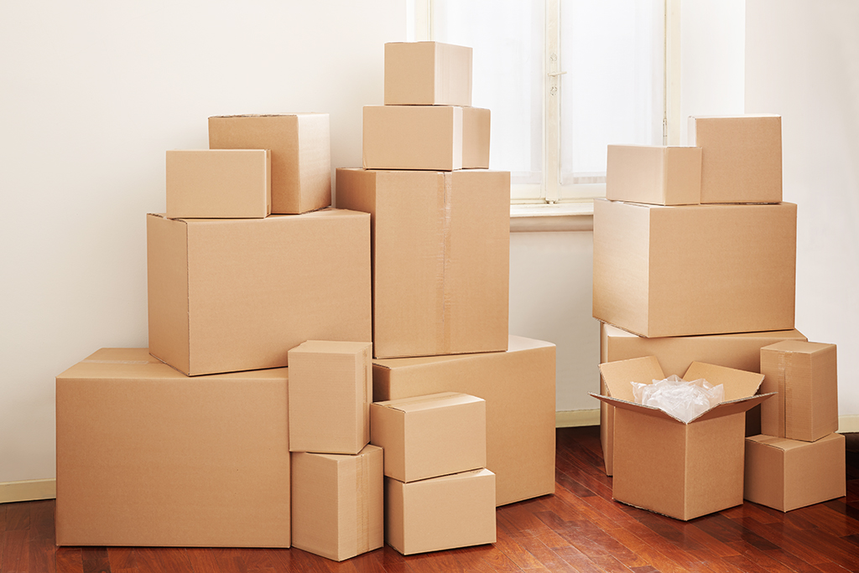
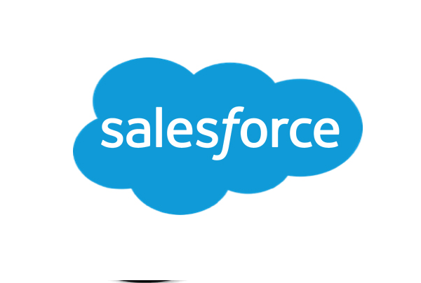

6Remember
6R is about applications
and data, platform components, technical building blocks, tools (development, test, CI/CD, monitoring, operations), procedures and staff
Reorganization of applications and components should be considered
consolidation and splitting off (preferably prior to migration)
You will not migrate everything at once
cater for hybrid environments (multi cloud and on prem) and a prolonged transition period
The way IT services are charged to the business and costs are allocated can play an important role
cloud makes fine grained cost allocation a possibility (usage based); ideally matched by fine grained generated value monitoring
Leave behind!

Slide 26
Applications and Technology Components [no longer] in use
Applications
Applications
Features
pages, reports, jobs, service, API
Data – hot | lukewarm | cold; GDPR/ PII status
Technology Platform
Java EE
JMS, JSP/JSF, EJB, JPA, JTA, JAX-WS
Oracle SOA Suite
Oracle Forms
Mendix
Components
modules, libraries, packages, tables
Oracle WebLogic
ODI
Oracle Reports
.NET
Docker
Oracle APEX
RHEL 5.x
Oracle Database
Windows 7
MySQL

Slide 27
Applications and Technology Components [no longer] in use
Applications
Applications
Features
pages, reports, jobs, service, API
Data – hot | lukewarm | cold; GDPR/ PII status
Technology Platform
Java EE
JMS, JSP/JSF, EJB, JPA, JTA, JAX-WS
Oracle SOA Suite
Oracle Forms
Mendix
Components
modules, libraries, packages, tables
Oracle WebLogic
ODI
Oracle Reports
.NET
Docker
Oracle APEX
RHEL 5.x
Oracle Database
Windows 7
MySQL

Slide 28
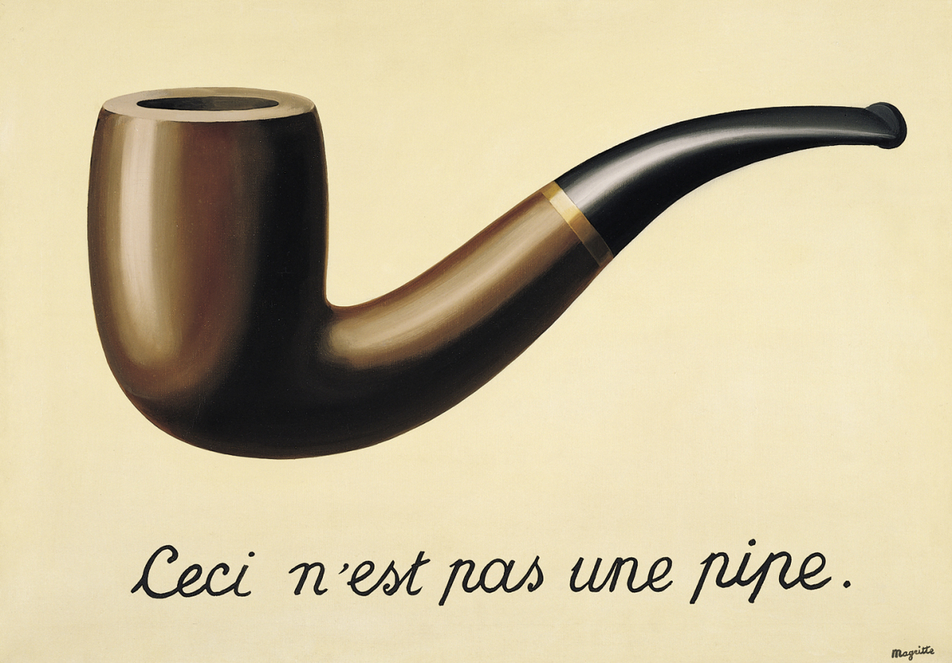
Ce ci

Slide 29
Ce ci
Ceci n’est pas un database

Slide 30
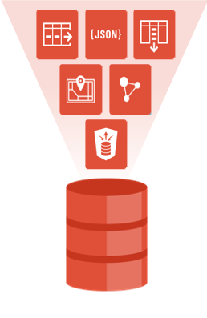
Oracle Database
Is much more than just a relational store of data and SQL query engine
Application Platform
PL/SQL
Stored Java
MLE (multi language engine)
Embedded PL/SQL Gateway, ORDS
APEX
Oracle Database features
Audit
Virtual Private Database
Edition Based Redefinition
Flashback
Spatial and Graph
Advanced Analytics and Machine Learning
…

Slide 31
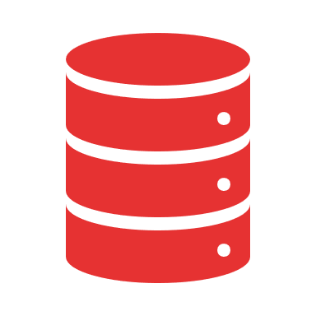

6R with Oracle Database
PaaS
IaaS
SaaS
PaaS
IaaS
IaaS

Slide 32
Retire Oracle Database
SaaS
PaaS
IaaS

Slide 33
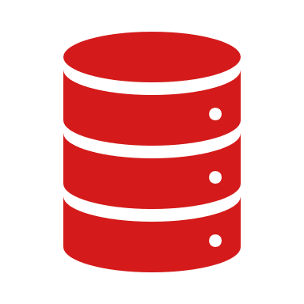
Retain (and Refurbish) Oracle Database
SaaS
PaaS
Clean Out unused, Upgrade (to 19c LTS), (De) Consolidate, Polish to make Shine (leverage now free Advanced Analytics, Spatial, Graph), Data Life Cycle Management
IaaS

Slide 34
Rehost Oracle Database
SaaS
Run Oracle Database on IaaS (Bare Metal, VM, Kubernetes); benefit from (large, flexible) scale and managed infra.
Refurbish (upgrade to 19c, …)
PaaS
IaaS

Slide 35

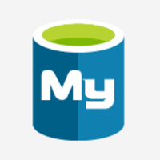
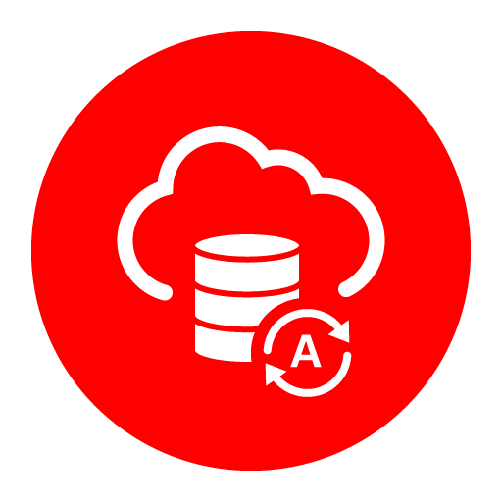
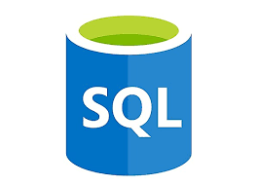
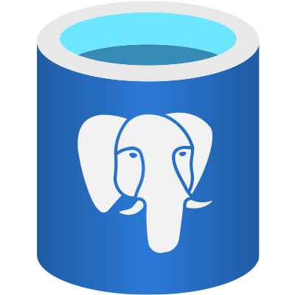
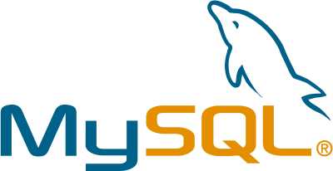
Replatform Oracle Database
PaaS
SaaS
PaaS
PaaS
IaaS
Same architecture, same code and database design – different RDBMS
Same architecture, same code and database design – different RDBMS
Same architecture, same code and database design – different RDBMS
Same Database platform –
now fully managed
Same Database platform –
now fully managed, serverless
Notes:
How can I migrate my existing Oracle Database to Oracle Autonomous Database?
Since an ADB database has some restrictions on the object types and Oracle Database Options you need to use a logical migration method rather than a physical one.
The main migration tool for migrating to ADB is Data Pump. You can export your schemas and import them into ADB using Data Pump. To sync up the additional/incremental changes on the source database during the export/import process you can use GoldenGate or GoldenGate Cloud Service to replicate those changes to ADB.
In the current release you cannot use physical migration methods like backup/restore, Data Guard, database clones, and transportable tablespaces to move your existing database to ADB.
Can I import an existing Oracle Database schema into Oracle Autonomous Database?
Yes. You can use Data Pump to export the source schema, move the dump files to the object store, and use Data Pump Import to load them into your ADB database.
Can I move my on-premises Oracle Database to Oracle Autonomous Database using RMAN backup and restore?
No, RMAN restore into ADB is not supported. You need to use one of the supported migration methods outlined above.

Slide 36
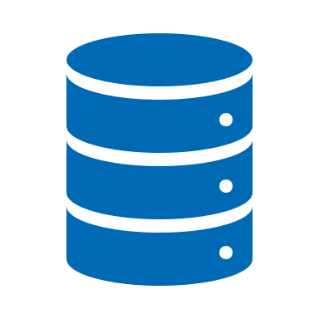
Refactor (Rearchitect) Oracle Database
Substantially rethink the design and solution - redesign data model, leverage PDBs, introduce non-relational data, apply architecture concepts (microservices, event sourcing, CQRS), introduce additional data stores (NoSQL, lake, blockchain, ..)
SaaS
PaaS
IaaS

Slide 37
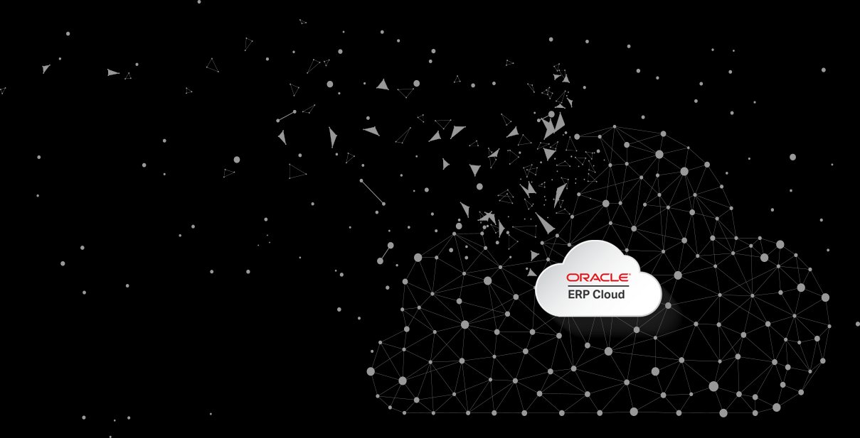
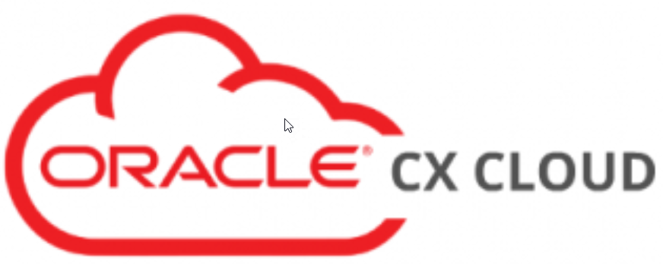
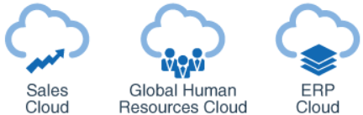
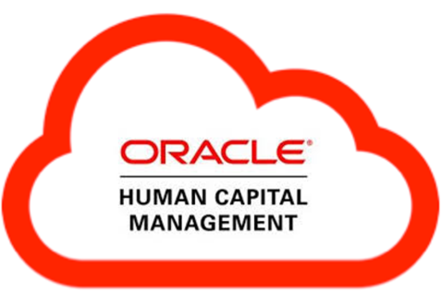
Repurchase (Oracle Database)
Replace an application using an Oracle Database with a SaaS offering (that includes its own datastore); data needs to be migrated into the SaaS platform, integration and custom applications are likely needed to fully enable the SaaS.
SaaS
PaaS
IaaS

Slide 38

Multicloud
PaaS
IaaS
SaaS
PaaS
PaaS
IaaS
IaaS
Public cloud on private premises

Slide 39

6Reinventing Oracle Database
PaaS
IaaS
SaaS
PaaS
IaaS
IaaS
Notes:
How can I migrate my existing Oracle Database to Oracle Autonomous Database?
Since an ADB database has some restrictions on the object types and Oracle Database Options you need to use a logical migration method rather than a physical one.
The main migration tool for migrating to ADB is Data Pump. You can export your schemas and import them into ADB using Data Pump. To sync up the additional/incremental changes on the source database during the export/import process you can use GoldenGate or GoldenGate Cloud Service to replicate those changes to ADB.
In the current release you cannot use physical migration methods like backup/restore, Data Guard, database clones, and transportable tablespaces to move your existing database to ADB.
Can I import an existing Oracle Database schema into Oracle Autonomous Database?
Yes. You can use Data Pump to export the source schema, move the dump files to the object store, and use Data Pump Import to load them into your ADB database.
Can I move my on-premises Oracle Database to Oracle Autonomous Database using RMAN backup and restore?
No, RMAN restore into ADB is not supported. You need to use one of the supported migration methods outlined above.

Slide 40
Cloud Transformation – Architecture Guidelines
Managed PaaS over IaaS
and FaaS over CaaS over VM over Bare Metal
N/N-1 – only latest [long term] supported version
Standard Building Blocks for Platform Components
Pay per use, only use what and when is required
scale down and switch off whenever possible
Automation and Infrastructure as Code (no hands touch infra)
provisioning & deployment, monitoring & notification
Data Compliance (such as GDPR)
Fine Grained Cost Allocation
Appropriate availability and disaster recovery
multi region for mission critical, at least multi availability “unit”
Each Bare Metal Server | VM | Container | Function has a single purpose

Slide 41
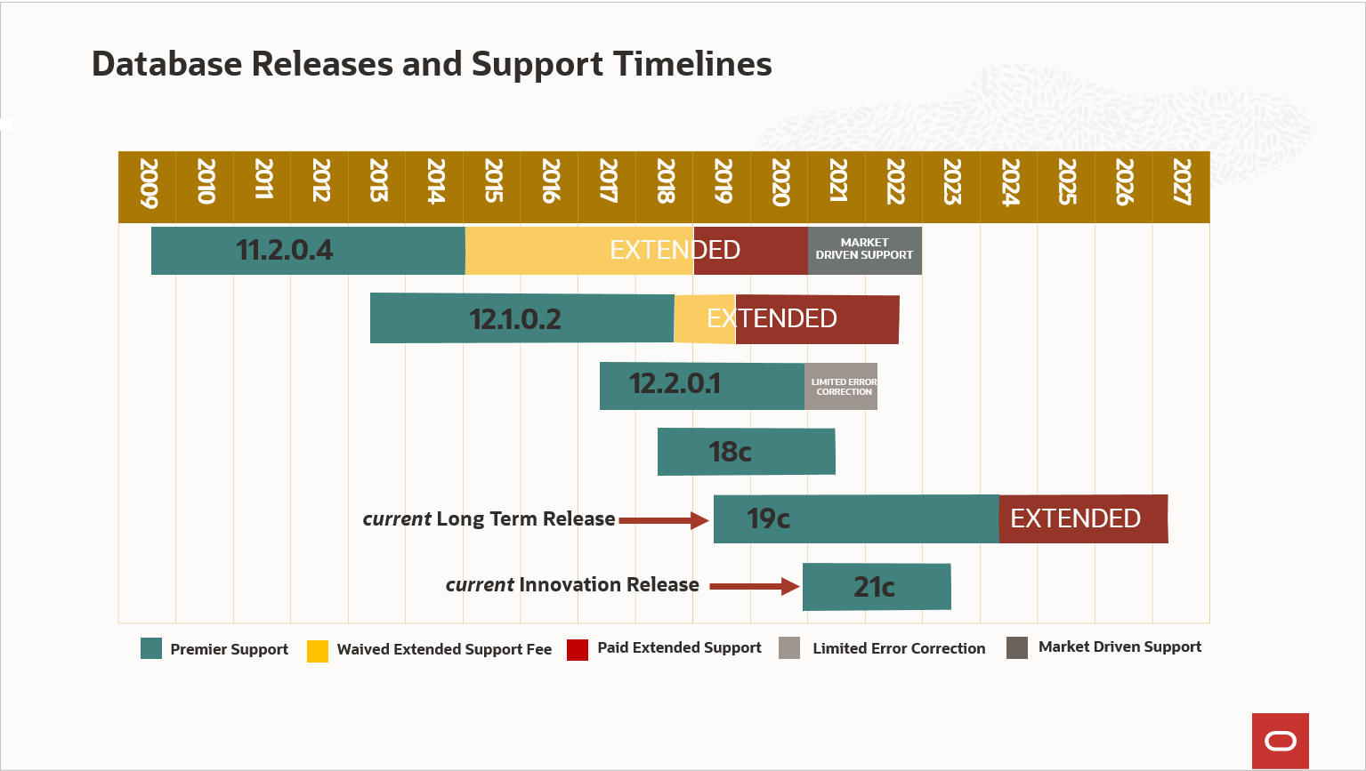
Decision Tree
21c

Slide 42


repurchase
Added value autonomous from much lower ops costs and admin effort (< 10% DBA) & dependence on specialist; also more and earlier features; however higher cloud-usage-cost, introduction of OCI and the connect OCI ⬄ Azure
SaaS
Repurchase Retain Retire application
AQ, EBR, Flashback, XMLDB, Text, HTTP, Application Context, VPD, Stored Java, …
Consolidation of multiple databases; Split up of database into mulitple
On Prem Oracle Database
Forms, APEX, COTS
retire
Rehost Replatform application
Oracle specific DB-features?
Oracle Autonomous
OCI auto-
nomous
provides bonus value
Satisfies conditions
for
OCI Auto-
nomous
Applications independent Oracle?
because of cost, risk, duration, fitness for automated migration
version == 19c?
Modify App/DB logic
Reconstruct Application
PL/SQL logic?
PL/SQL too
complex?
Up grade to 19c
Modify DB Logic
No direct access to OS, file system, network; no dbms_pipe, stored java, no log miner, WM, sharding, …
Upgrade Possible?
No applications that are not 19c ready / or use DB features deprecated in 19c?
Modify App/ PLSQL
Oracle Database on Azure IaaS
Replatform logic Migrate to PostgreSQL
Do the applications access the database over JDBC/ODBC and SQL? Or through stored procedure calls or with REST API calls?
Consolidation of multiple databases; Split up of database into multiple
Rela-tional data-usage ?
Preparation for automated migration of PL/SQL
Azure DBaaS relational (SQL Database PostgreSQL)
Migrate relational DBaaS Azure
Consolidation of multiple databases; Split up of database into multiple
Consolidation of multiple databases; Split up of database into multiple
Migrate managed DBaaS Azure
Azure DBaaS non relational (CosmosDB, Redis)
Refactor application
Azure Managed PaaS
Notes:
* Applicatie onafhankelijk van Oracle: APEX, Forms, Oracle Reports, andere database via DB link => afhankelijk van Oracle DB.
Daartegenover: standaardapplicatie die zowel tegen Oracle DB als SQL Server is gecertificeerd is onafhankelijk van Oracle. NB: applicaties die Oracle specifiek SQL uitvoeren of PL/SQL objecten aanroepen kunnen (waarschijnlijk) niet zonder aanpassing naar een andere relationele database gaan praten
* Oracle DB specifieke features – zoals supplied packages, VPD, fine grained auditing, Flashback, Advanced Analytics, Edition Based Redefinition, XMLDB, Oracle Text, HTTP-verkeer in/uit, Stored Java, in memory database, virtual columns, application context, spatial; ook database links
* PL/SQL té complex – uiteindelijk ter beoordeling van Ahold – op basis van kosten, risico, doorlooptijd, geschiktheid voor automatische migratie.
Aspecten (vaststellen door steekproef, interview en onderzoek data dictionary)
- veel regels code (absoluut, per program unit)
- complexe mechanismen gebruikt (UTL_FILE, UTL_TCP, APEX)
- beschikbaarheid functionele specificaties
- inspanning om opnieuw te bouwen
- testbaar (beschikbaar automatische
- leesbaar/onderhoudbare code (cyclomatische complexiteit, SonarQube score , …)
Relationeel Datagebruik – praat de applicatie via JDBC/ODBC in termen van SQL tegen de database? of wellicht stored procedure calls? Of in REST API calls? Maakt de onderliggende (opslag)structuur veel uit voor de applicatie?
* Upgrade mogelijk?
Het is mogelijk dat de applicaties die de database gebruiken een upgrade in de weg staan

Slide 43
Oracle Database
Explore the starting point
Which release (11gR2, 12cR1, 12cR2)
Which edition (XE, SE2, EE)
Options?
Advanced Analytics, Graph and Spatial
Partitioning, Compression, In Memory, Multitenant, Database Vault, Advanced Security, Label Security, Real Application Testing, Data Masking and Subsetting
RAC, Active Data Guard
Hardware?
ODA, Exadata, “regular”
Interactions from within Database with the environment: OS, File System, Network, other databases (links, gateways)
Notes:
features not supported on Autonomous Database: https://docs.oracle.com/en/cloud/paas/atp-cloud/atpug//experienced-database-users.html#GUID-B6FB5EFC-4828-43F4-BA63-72DA74FFDB87
Oracle Real Application Testing
Oracle Real Application Security Administration Console (RASADM)
Oracle OLAP
Oracle R capabilities of Oracle Advanced Analytics
Oracle Industry Data Models
Oracle Tuning Pack
Oracle Database Lifecycle Management Pack
Oracle Data Masking and Subsetting Pack
Oracle Cloud Management Pack for Oracle Database
Oracle Multimedia
Java in DB
Oracle Workspace Manager

Slide 44

Using any of these?
utl_file
utl_http, utl_tcp, utl_smtp
database link
dbms_epg
dbms_scheduler, dbms_job
external procedure
external table
stored Java
DIRECTORY
LONG and LONG RAW

Slide 45

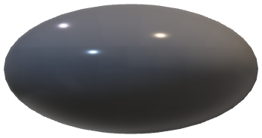
ETL
Replication

Slide 46
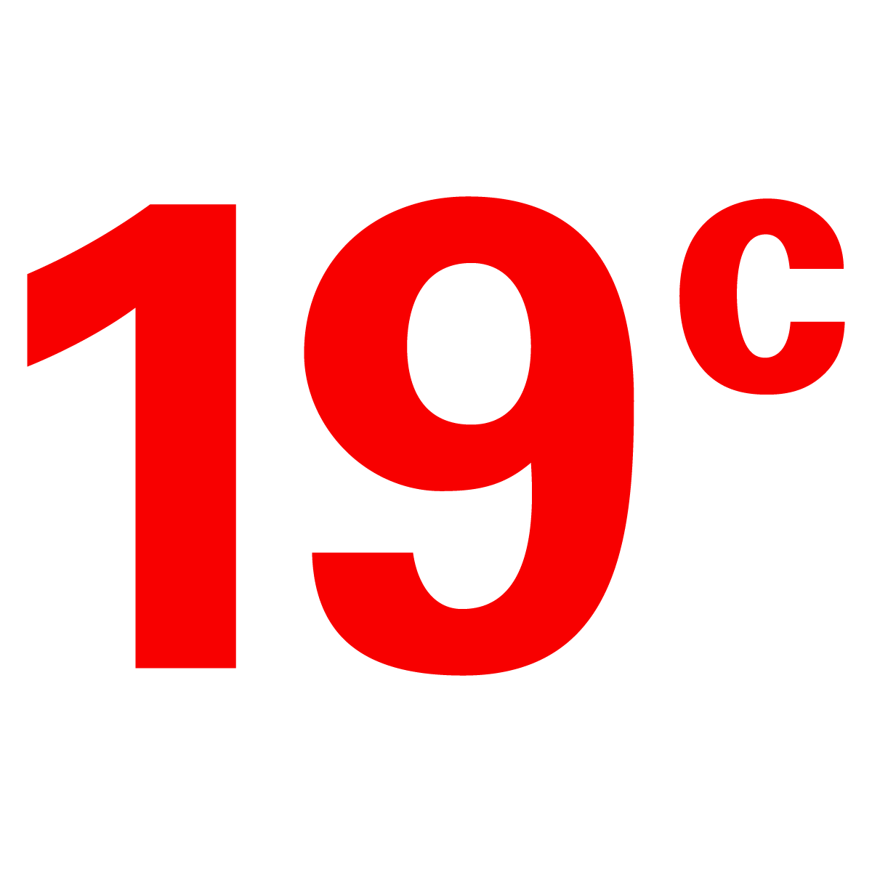
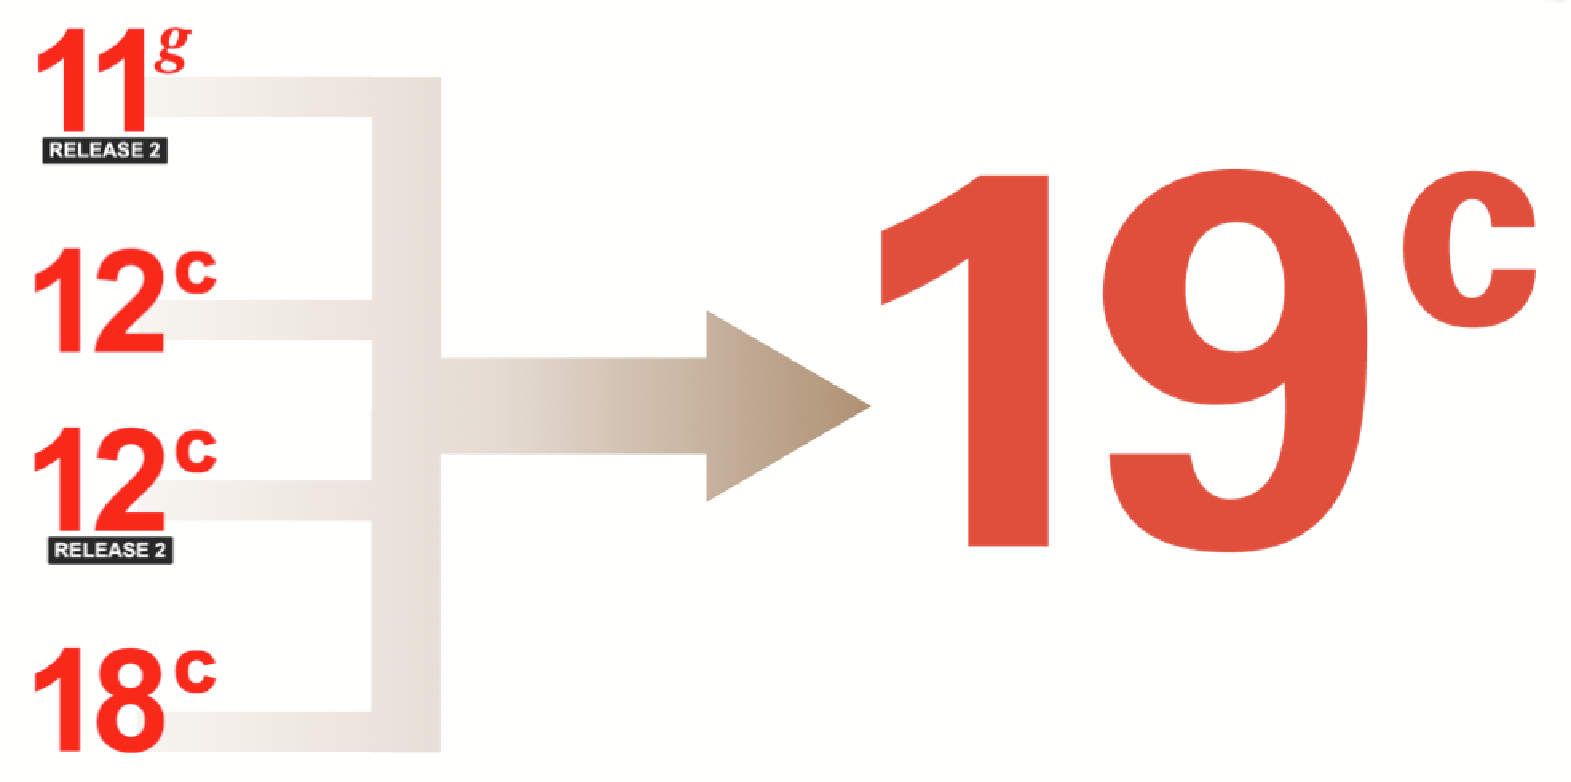
SaaS
Repurchase application
Optionally/preferably upgrade to Oracle Database 19c and move to multitenant architecture (with 1-3 custom PDBs)– depends on roadmap
Added value autonomous from much lower ops costs and admin effort (< 10% DBA) & dependence on specialist; also more and earlier features; however higher cloud-usage-cost, introduction of OCI and the connect OCI ⬄ Azure
On Prem
Oracle Database
Retain /Retire application
version == 19c ?
OCI auto-
nomous
provides bonus value
Satsfies conditions
for
OCI Auto-
nomous
Oracle Autonomous Database
Looking at technical limitations in applications or limitations in business (budget, planning)
Modify DB & App Logic
Upgrade is possible?
Up grade to 19c
Consolidation of multiple databases; Split up of database into multiple
Consolidation of multiple databases; Split up of database into multiple
Oracle Database 19c on Azure IaaS
Upgrade to Oracle Database 19c and move to multitenant architecture (with 1-3 custom PDBs)
Upgrade to Oracle Database 19c and move to multitenant architecture (with a single custom PDB)
Upgrade to 19c
Oracle Database < 19c on Azure IaaS
46

Slide 47
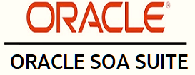
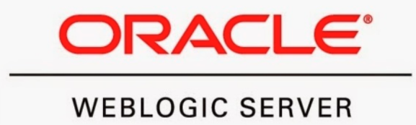
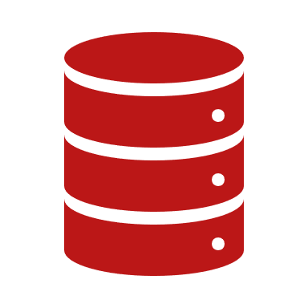
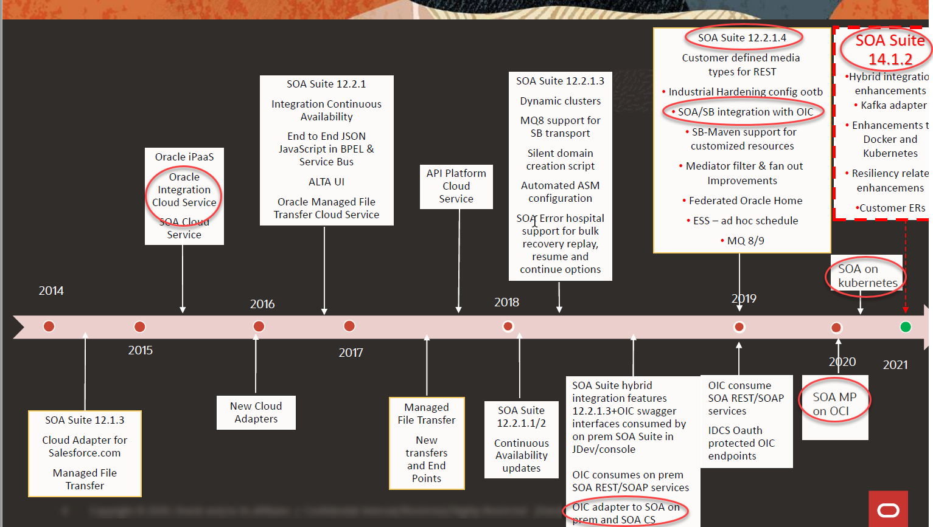
6R Oracle SOA Suite
The Dutch company also runs a number of integration scenarios and publishes WebServices & APIs
It uses SOA Suite & OSB
11g and 12.1.3
It has done some work with Dell Boomi
What is the 6R verdict on its Oracle based integrations?
Notes:
https://www.oracle.com/a/ocom/docs/middleware/fusion-middleware-statement-of-direction.pdf

Slide 48


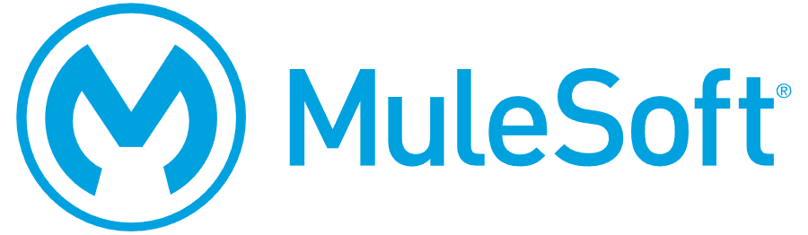
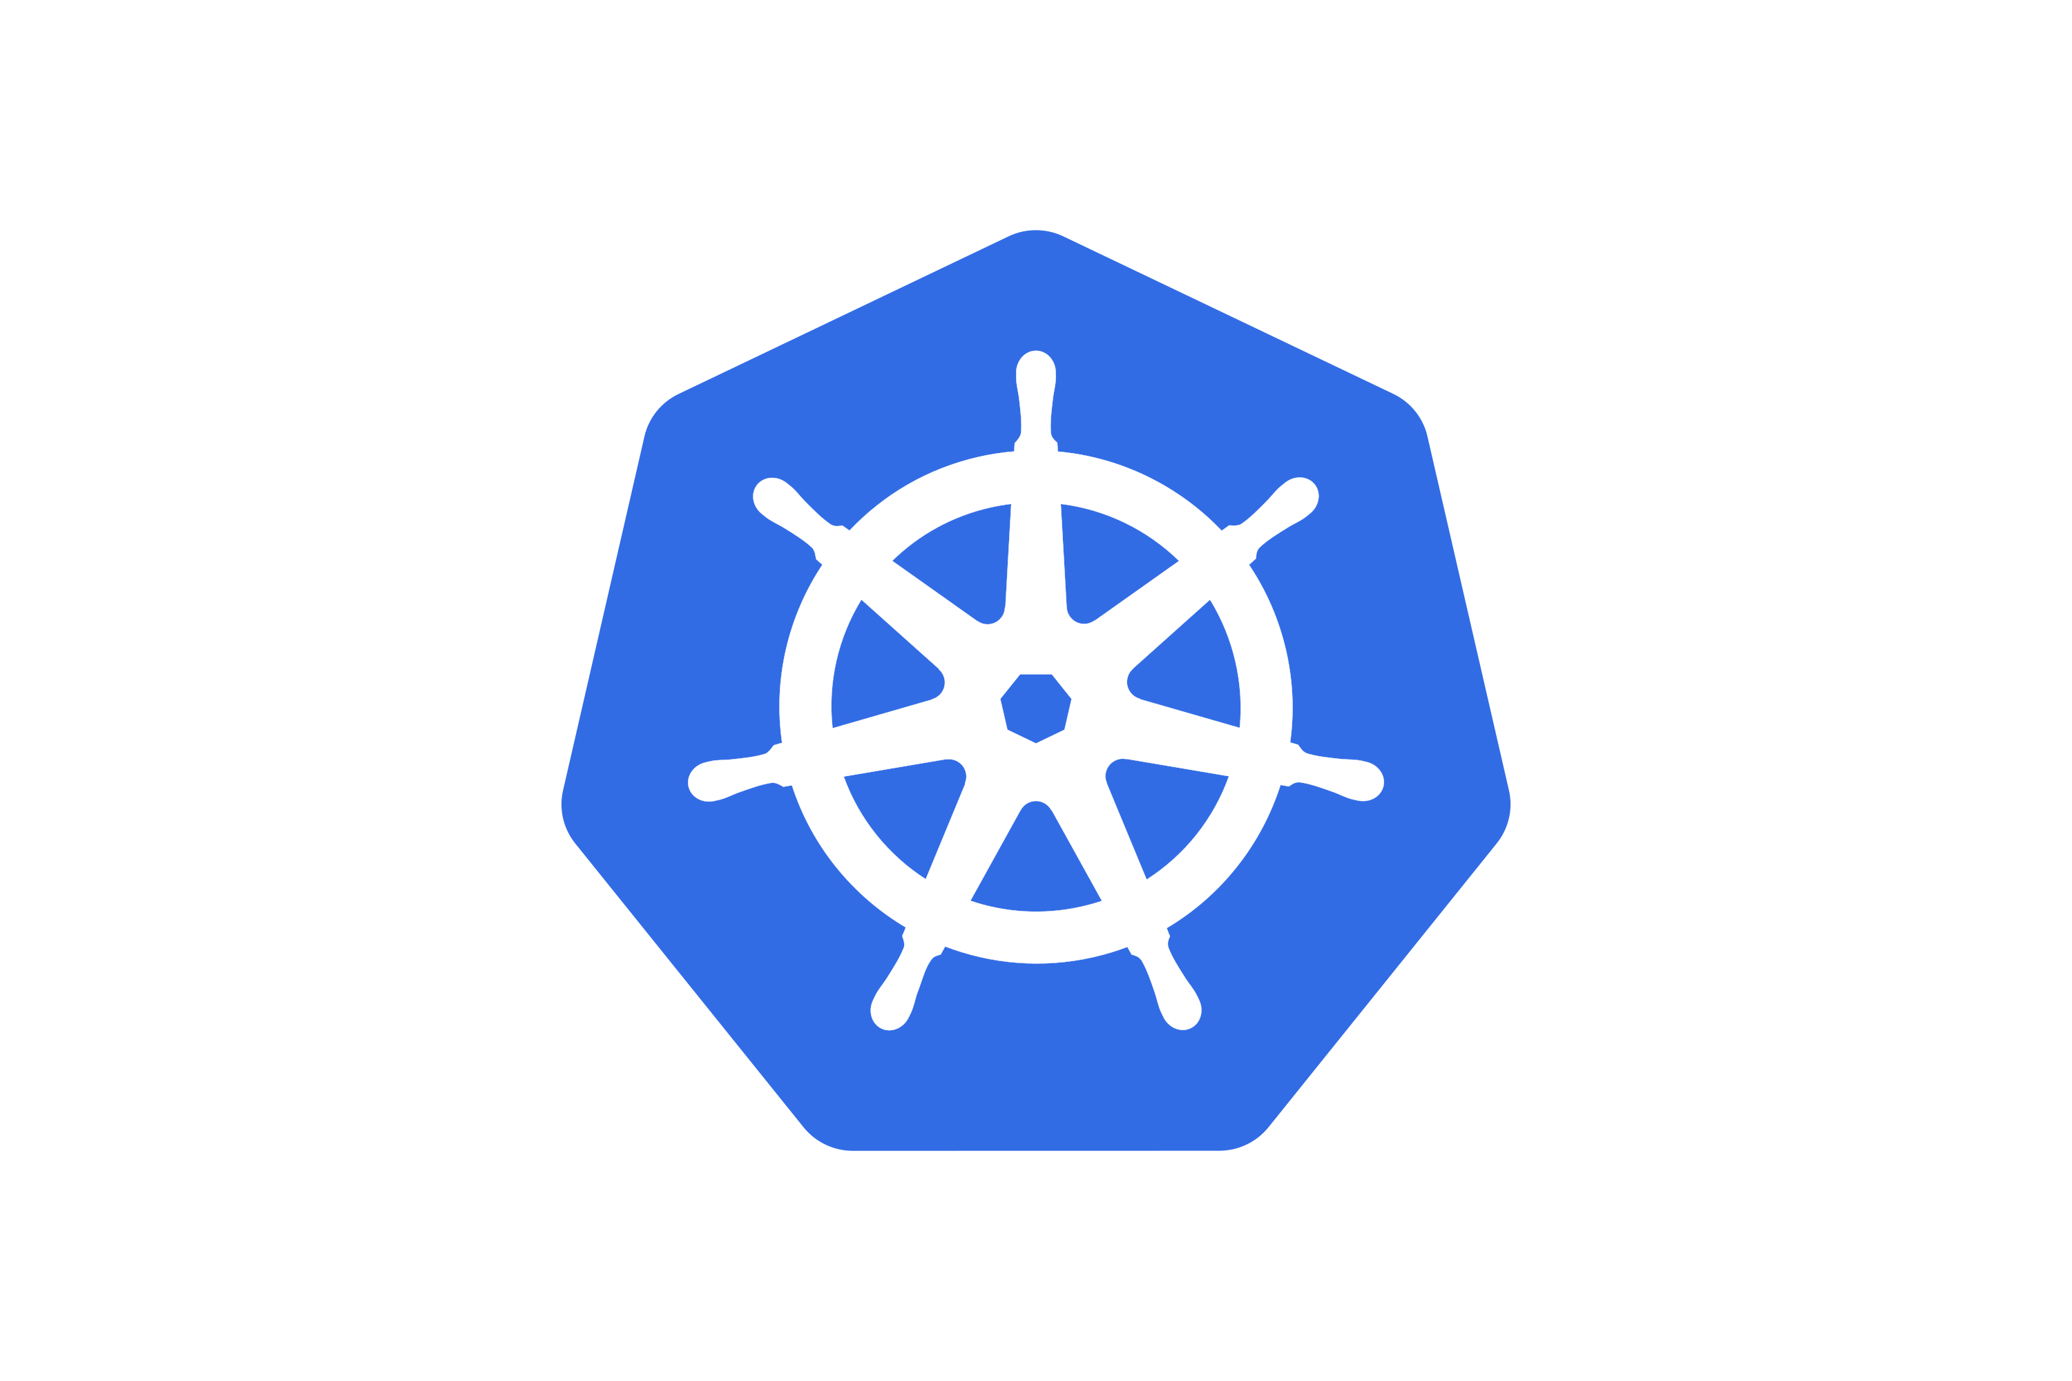
6Reinventing SOA Suite
Azure Cloud Native integration (functions, API Management, connectors, Logic Apps, Data Factory, …)
PaaS
OCI Cloud Native (Functions, Streaming, Events, …)
OCI API Gateway
IaaS
SOA Suite with Kubernetes Operator on OCI Kubernetes Engine
SaaS
OCI Data Integration for ETL style data pipelines
PaaS
IaaS
Oracle Integration Cloud (with on-prem agent & SOA Suite connector)
SOA Suite installed in VM or bare metal or on AKS (just like On Prem)
IaaS
SOA Suite VM image from OCI Marketplace on OCI Compute
SOA Suite – upgrade to 12.2.1.4 (and 14.1.2); with OIC adapter;
possibly run on K8S
SOA Suite VM image from OCI Marketplace on OCI Compute
Oracle Integration Cloud (with on-prem agent & SOA Suite connector)
Notes:
How can I migrate my existing Oracle Database to Oracle Autonomous Database?
Since an ADB database has some restrictions on the object types and Oracle Database Options you need to use a logical migration method rather than a physical one.
The main migration tool for migrating to ADB is Data Pump. You can export your schemas and import them into ADB using Data Pump. To sync up the additional/incremental changes on the source database during the export/import process you can use GoldenGate or GoldenGate Cloud Service to replicate those changes to ADB.
In the current release you cannot use physical migration methods like backup/restore, Data Guard, database clones, and transportable tablespaces to move your existing database to ADB.
Can I import an existing Oracle Database schema into Oracle Autonomous Database?
Yes. You can use Data Pump to export the source schema, move the dump files to the object store, and use Data Pump Import to load them into your ADB database.
Can I move my on-premises Oracle Database to Oracle Autonomous Database using RMAN backup and restore?
No, RMAN restore into ADB is not supported. You need to use one of the supported migration methods outlined above.

Slide 49
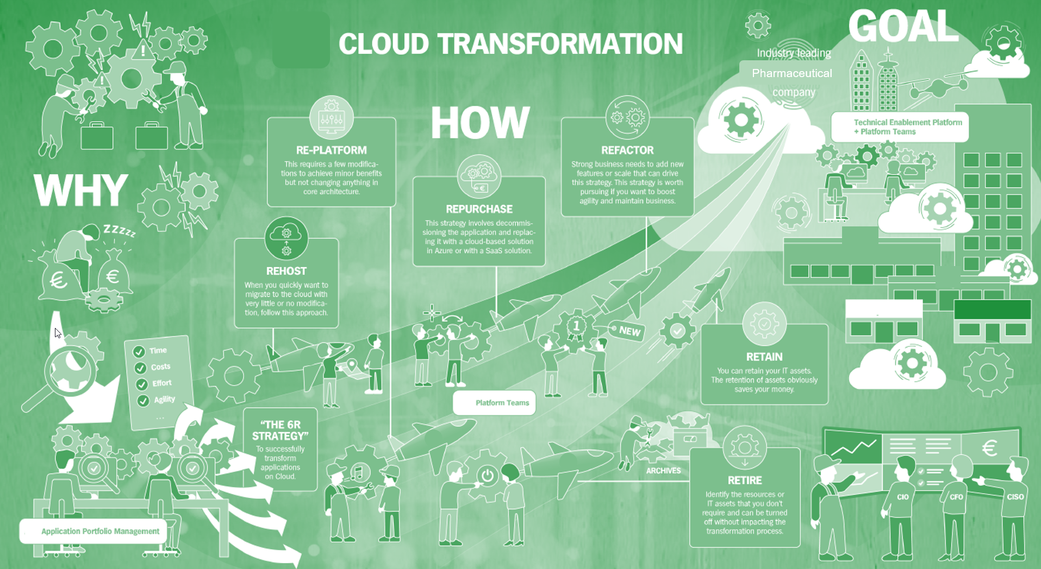
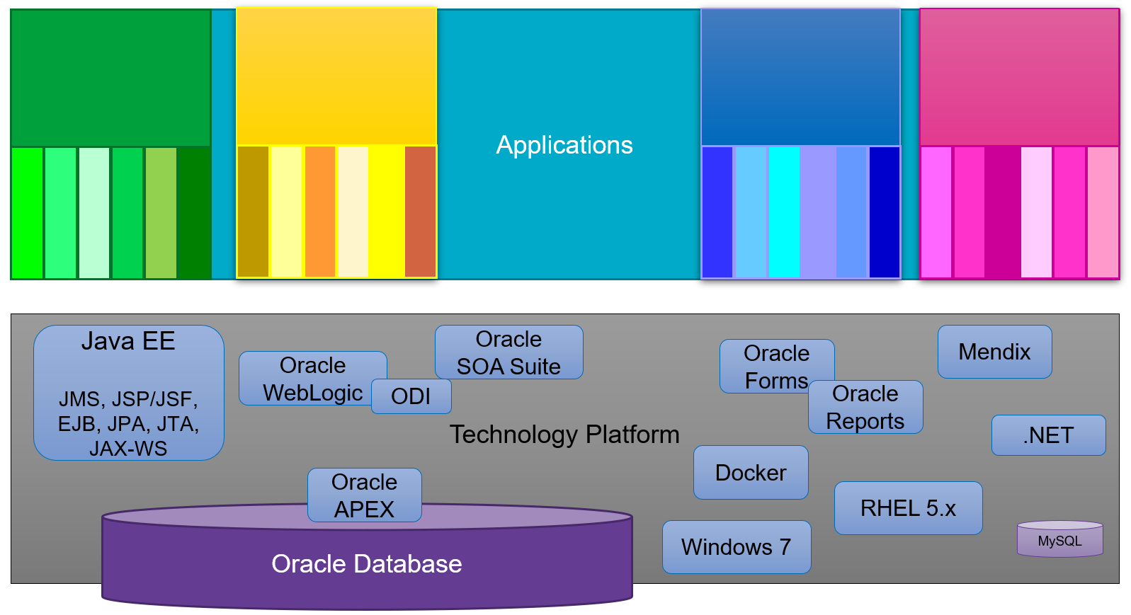
Conclusion
6R is triggered by the cloud
but should be considered periodically regardless of cloud
Decisions are made per application, data set and per technology component
and per feature, per data object, per server and per technology instance
Not deciding to make a move is also making a decision
that requires arguments and justification
The 6Roadmap will need continuous refinement
Knowing the current situation is crucial for planning and decision making
which technology component for which applications and which data sets used for which business purposes – that will evolve in which way?
what is the generated business value and therefore the justifiable TCO

Slide 50
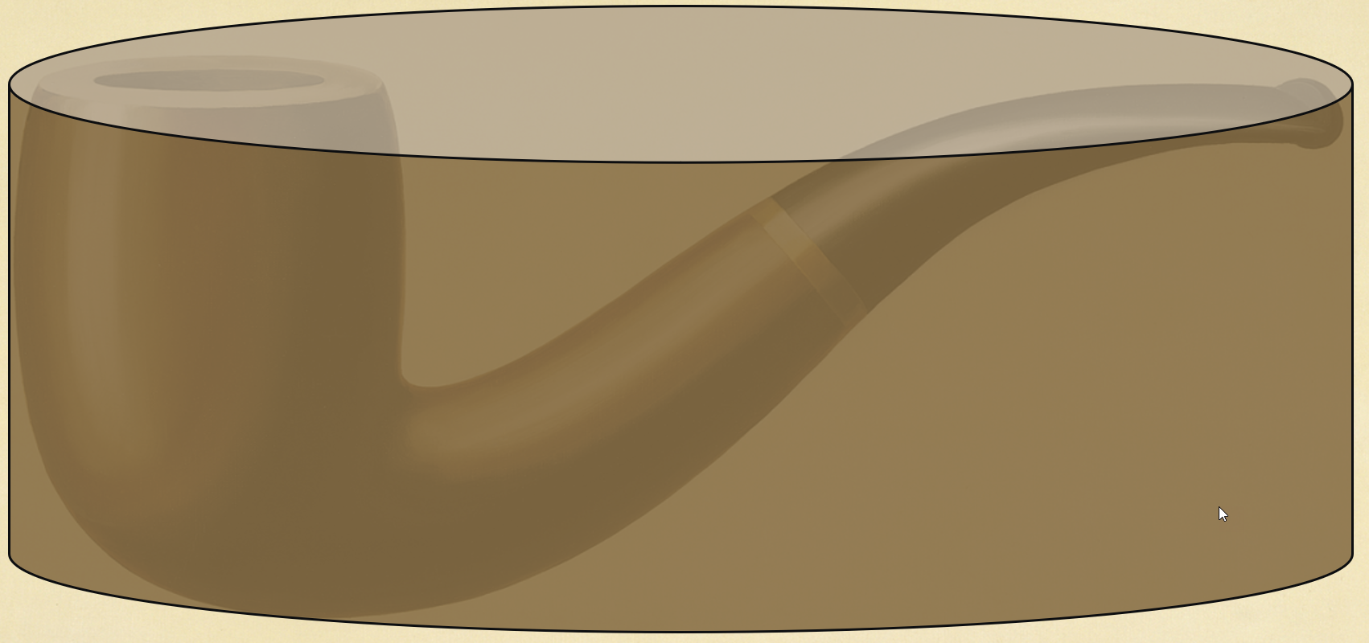
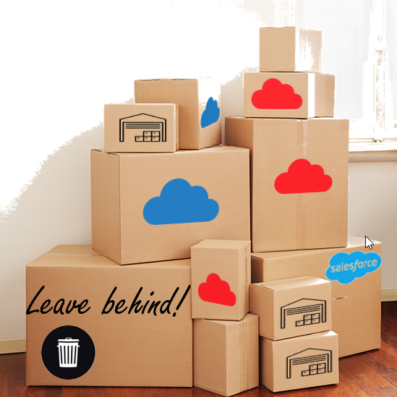
Conclusion
Cloud is not an easy solution for the big problems
it can quickly help with scale, security, focus on business value, automation, innovation, TCO, and with starting the right discussions
it does not add agility to existing business critical applications and teams
and adopting the cloud is not a trivial operation
Ce ci n’est pas un database (c’est bien plus qu’un database)
A hybrid landscape (cloud – multicloud - on prem) is likely to exist for a fairly long time
Secure, affordable network connections between cloud(s) and on prem
Some form of data replication is to be expected
Integration flows - streaming, event-based and batch ETL-style – are required to tie the environments together
There is no excuse for not starting your cloud journey right now
except if you are already on your way
Have a safe journey!

Slide 51


For more information about this Session, please contact:
Lucas Jellema
For details about joining RMOUG, please go to our Join Us Page:
rmoug.org/Join Us
or contact:
Tim Mishek, Membership Director
membershipdir@rmoug.org
lucas.jellema@amis.nl | technology.amis.nl
@lucasjellema | lucas-jellema

